Slide 1


EMPLOYEE SUCCESS ANALYTICS
AT NEXTGEN CORP
Presented by Omolara Buhari
Data analytics EU –class B-Cohort 25-04/ April cohort
Excel capstone project: SQL EMPLOYEE SUCCESS ANALYTICS AT NEXTGEN CORP
DATE: 2025-07-26

Slide 2
Presentation Outline
Snapshot of NextGen
Business Case
Data Description and Root Cause Analysis
Employee Retention Analysis
Performance Analysis
Salary Analysis
Recommendations
Conclusion

Slide 3

Introduction & Business Overview

Slide 4
Snapshot of NextGen Corp
NextGen Corp’s business focus is predominantly in the tech space, focusing on developing innovative solutions in software and hardware.
To gain a competitive advantage, NextGen Corp makes significant investments in talent acquisition and retention strategies aimed at attracting top talent and maintaining high employee satisfaction to drive growth

Slide 5
Snapshot of NextGen Corp
NextGen Corp. is a fast-growing tech company working in software and hardware. While the company attracts top talent and values employee satisfaction, it is now facing challenges with high staff turnover, uneven performance, and salary gaps across departments.
To keep growing successfully, the HR team needs a data-driven approach to:
Spot trends in staff retention and turnover.
Monitor employee performance across departments.
Ensure fair pay by comparing salaries and performance

Slide 6



Data Description & Root Cause Analysis

Slide 7
Data Description
Employees Table: Contains essential employee details like name, job title, hire date, salary, performance score, attendance rate, and department affiliation.
Departments Table: Contains the list of departments within NextGen Corp. (e.g., Engineering, Sales, HR, Marketing)
Performance Table: Tracks monthly performance scores of employees, allowing you to analyze performance trends over time
Attendance Table: Tracks attendance records for employees, including whether they were present or absent.
Turnover Table: Contains data on employees who left the company, including the reason for leaving.
Salaries Table: Provides salary data, including historical salary changes for each employee.

Slide 8

Employee Retention
Analysis

Slide 9
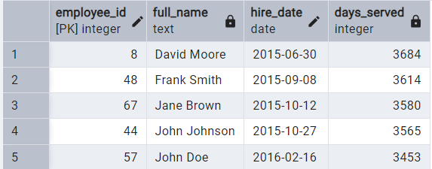
Who are the top 5 highest serving employees?
The highest-serving employee is David Moore, hired in
June 2015, having served 3678 days, followed by
Frank Smith with 3608 days, then Jane Brown,
John Johnson, and John Doe.

Slide 10
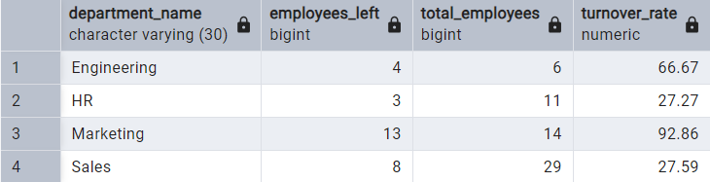
What is the turnover rate for each department?
Total No. of employees—60
Number of employees who left—28
HR - 3 – 27.27
Engineering - 4 – 66.67
Marketing - 13 – 92.86
Sales - 8 – 27.59

Slide 11
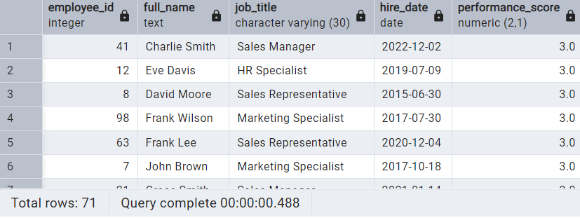
Which employees are at risk of leaving based on
their performance?
The employees at risk of leaving based on
Performance ratings below 3.5 are as shown
In total, 71 employees are at risk.

Slide 12
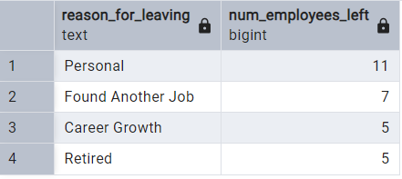
What are the main reasons employees are
leaving the company?
Employees are leaving NextGen Corp mainly for the following reasons:
Personal reasons (These could be factors outside of the employee’s control.)
Found other jobs
Career Growth
Retirement
Career growth and leaving for other jobs suggest a gap in talent retention

Slide 13

Performance Analysis

Slide 14

How many employees have left the company?
28 employees have left the company due to various reasons previously provided, such as personal decisions, career growth, or new job opportunities.
These figures provides a need to strengthen the employee engagement efforts and monitor retention trends

Slide 15
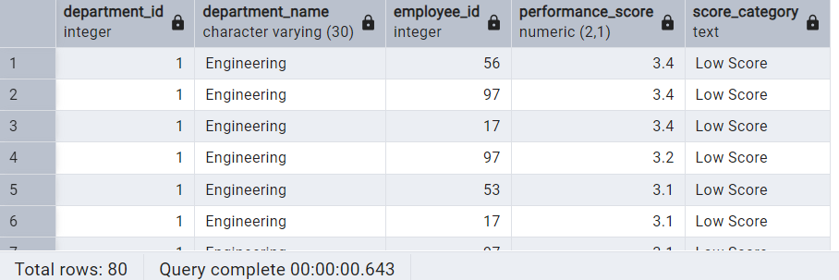
How many employees have performance score of 5.0 and below 3.5?
71 employees have performance scores below 3.5 in the following departments:
Engineering - 7
HR - 14
Marketing - 14
Sales - 36
9 employees have perfect performance scores of 5
Engineering - 0
HR - 1
Marketing - 2
Sales - 6

Slide 16
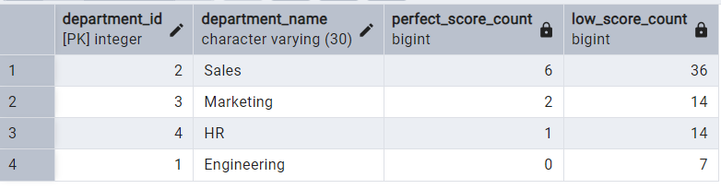
Which department has the most employees with performance scores of 5.0 and below 3.5?
The sales department has the most employees with perfect scores as well as performance scores below 3.5.
This wide performance range suggest inconsistency in either employee output or evaluation standard
Overall, there could be a need to train managers on performance evaluations and ratings.

Slide 17
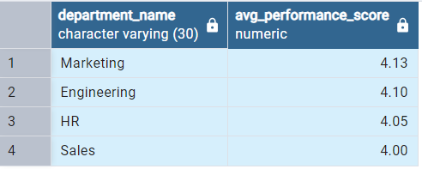
What is the average performance score by department?
Average performance score by department
Sales – 4.00
Marketing - 4.13
HR - 4.05
Engineering - 4.10

Slide 18
Salary
Analysis

Slide 19

What is the total salary expense for the company?
The company's total salary expenses are $4,850,000, reflecting the overall payment cost across the company. This figure is key for managing budgets, and supports workforce planning and future salary scaling decisions

Slide 20
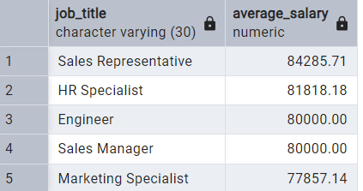
What is the average salary by job title?
Average Salary by job title is as follows:
Engineer - $80,000
HR Specialist - $81,818.18
Marketing Specialist - $77,857.14
Sales Manager - $80,000
Sales Representative - $84,285.71
In addition, engineers and sales managers both have a flat average salary of $ 80,000, showing consistency in the pay structure for these roles. The variation in salary across other job titles may reflect differences in job responsibilities, required skill levels, and performance-based incentives.

Slide 21

How many employees earn above 80,000?
26 employees earn above $80,000. This represents a notable segment of the workforce in the higher salary bracket. This likely reflects positions with greater responsibility, advanced skills, or strong performance

Slide 22
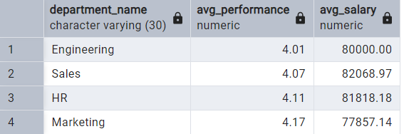
How does performance correlate with salary
across departments?
Avg performance across departments appears not to be well correlated, as marketing, with the highest average performance score, is the least paid.
Below, even HR and Sales with better performance show a record of the highest salary
This suggests that performance alone may not fully explain salary differences, and other factors such as market demand or department budget likely play a role in compensation

Slide 23
Conclusions
Concerning turnover reasons, 12 employees left because they found other jobs or to advance their careers, meaning 43% of turnover is due to controllable factors that the company can directly improve
More telling is that of this number, 7 employees left for other jobs, signaling a competitive threat and
suggesting that NextGen Corp’s talent is being attracted by better offers from rival companies
5 exits were due to limited career growth, highlighting urgent gaps in internal development,
advancement pathways, or talent engagement
43% of employees (26) earn above 80,000, contributing to the salary expense figure of $4,850,000 in NextGen Corp’s total budget. A salary survey to know how it compares in the industry may suggest that it redirects its salary structure to be more efficient

Slide 24
Recommendations
NextGen Corp should focus strategic efforts on talent retention and ensuring that career paths and
Plans are clearly outlined to reduce employee attrition that arises out of undefined career progression paths
or forced retirement.
Retention efforts should prioritize controllable causes, particularly by strengthening career development
programs and assessing how we compare to competitors in terms of culture and rewards.
Managers should be trained on performance management and assessment methods to understand how to set
goals and assess performance for goal achievement.

Slide 25
Recommendation contd..
There is a need to review the salary structure for the company to align the correlation more equitably, and employees whose performance is objectively assessed to be above average across departments
There is also a need for urgent intervention and the introduction of retention initiatives to prevent the risk of those currently at risk of leaving. A focus group set up to discuss employee pain points would be a good place to start
An Employee Assistance Program would also provide employees with an avenue to discuss issues that may be of concern.

Slide 26

THANK YOU
Presented by Omolara Buhari
Data analytics EU –class B-Cohort 25-04/ April cohort
Excel capstone project: SQL EMPLOYEE SUCCESS ANALYTICS AT NEXTGEN CORP
DATE: 2025-07-26

